Slide 1
Topic-: predictive maintenance Model
Submitted by:
NAME- Gaurav Rao
Roll no-202310101150095
Course- Btech Cs(Ds+Ai)

Slide 2
Project Overview
In this project we have a data of a company machine which work on rotaion principal
By help of predictive anylsis we check which one machine have problem and need of maintance and which one work perfectly

Slide 3
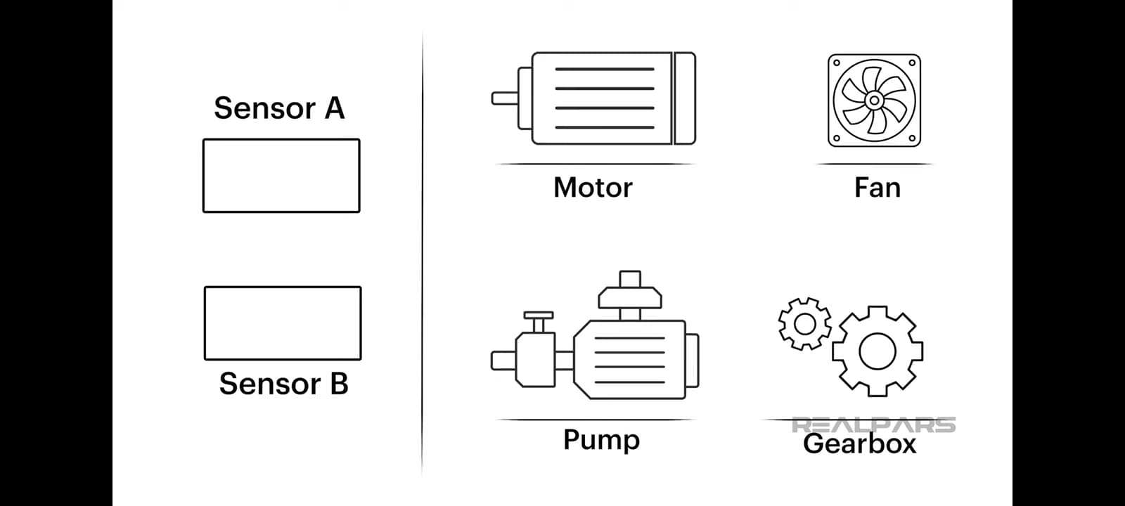
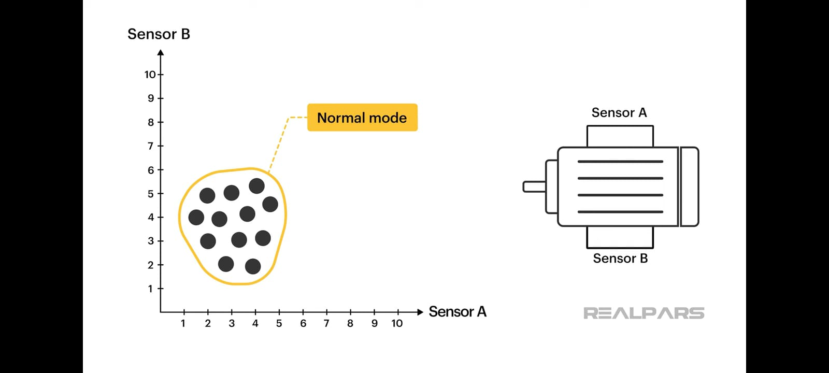
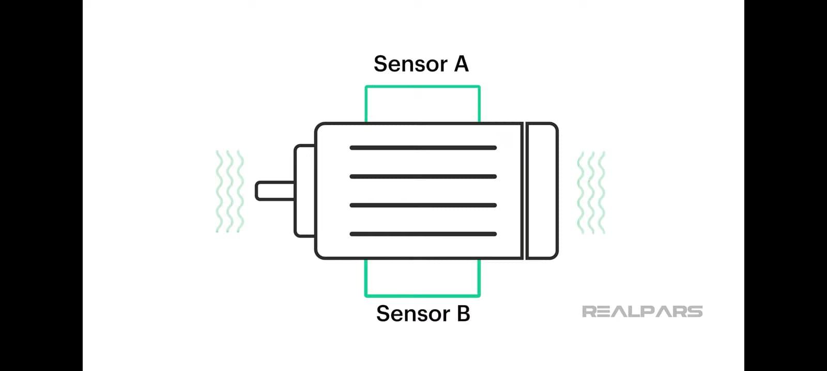
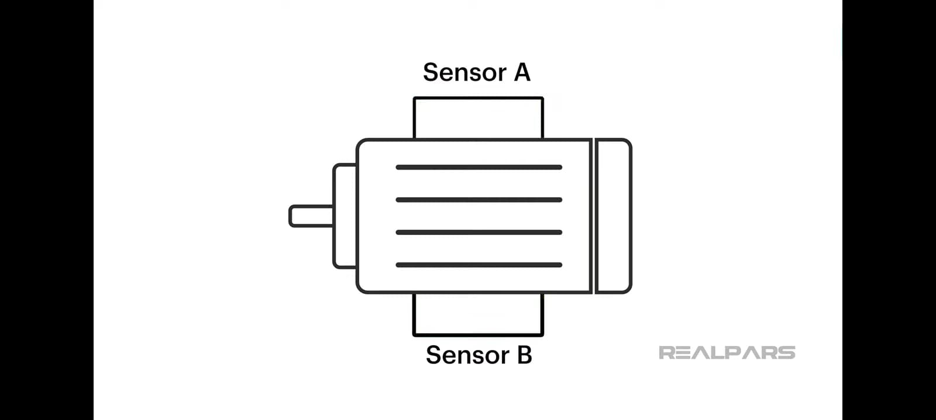
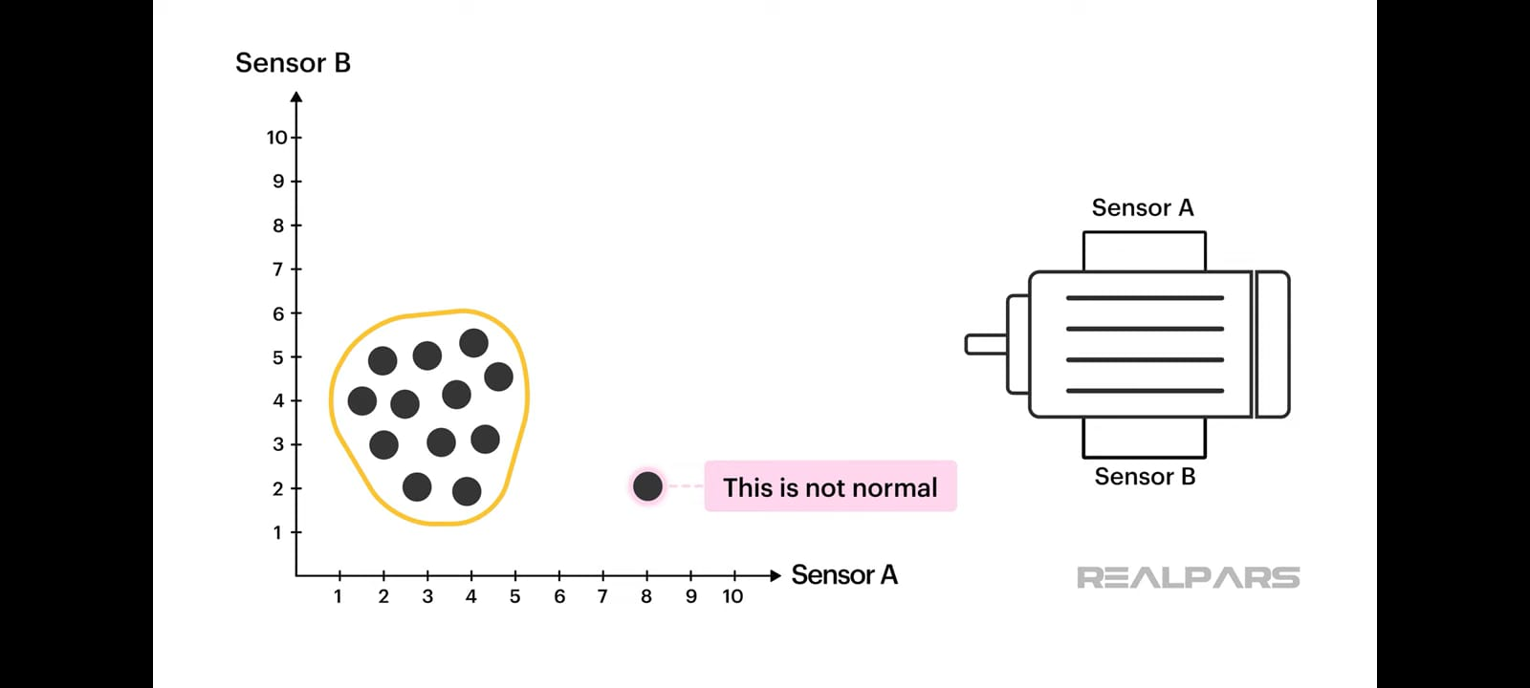
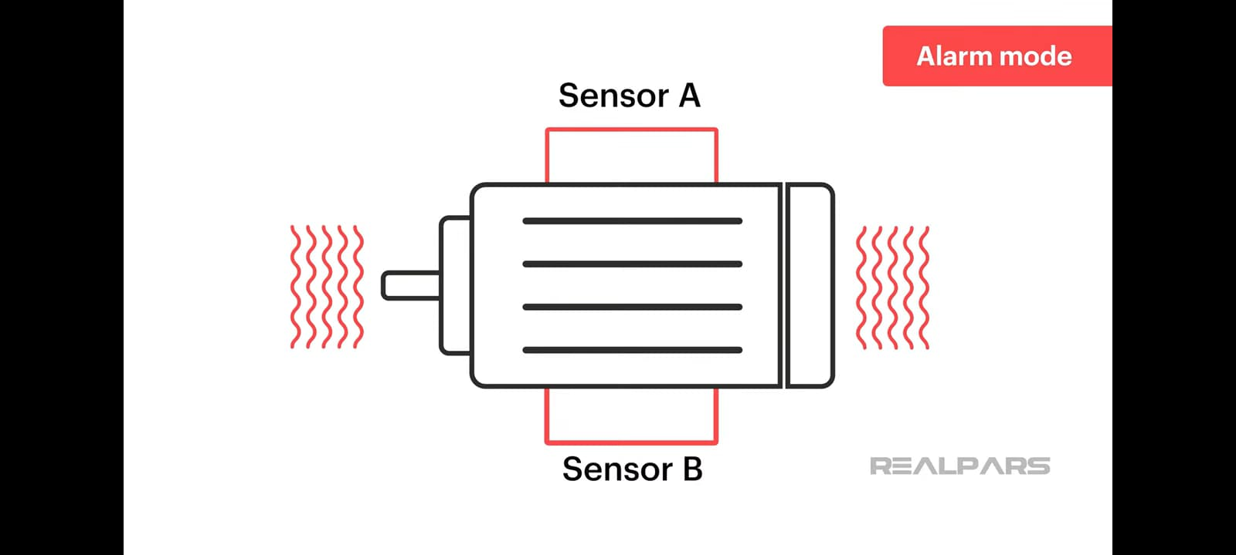


See with example what we going to do-:

Slide 4
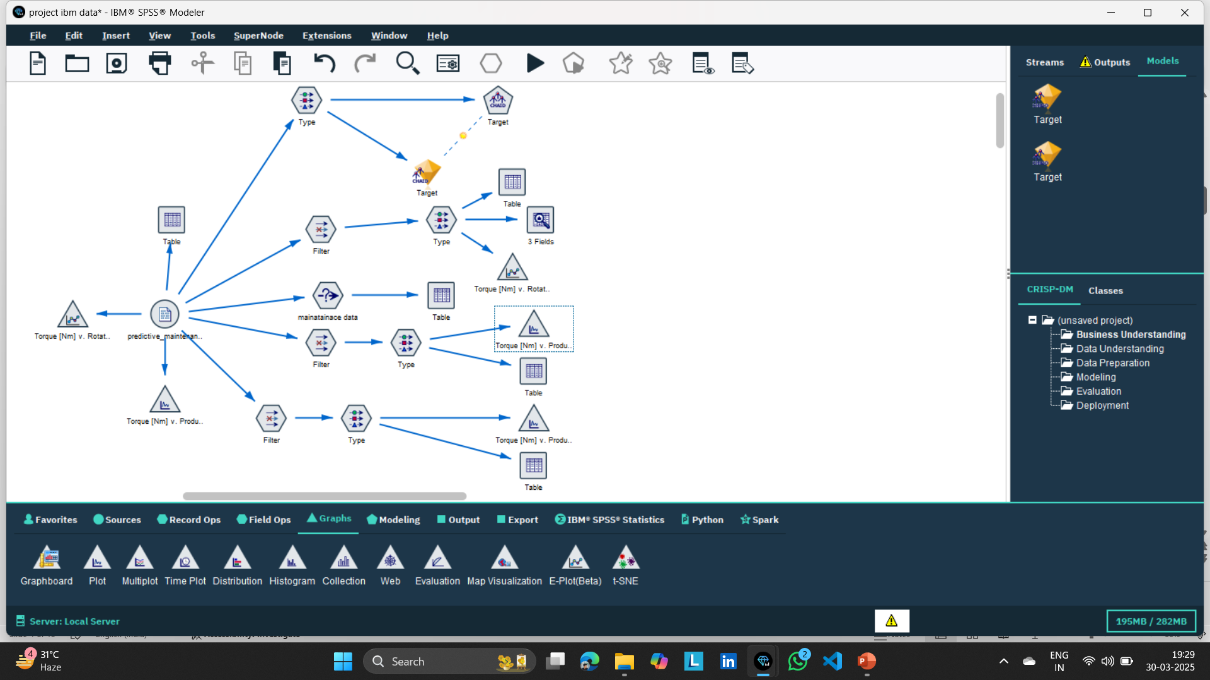
Predictive Model

Slide 5
categorize this model into Five part
Importing &Understanding data
Machine Issue:X%|perfect:y%
Extracting perfect machine data
Extracting Any issue machine Data
Extracting power Faliure Machine Data

Slide 6
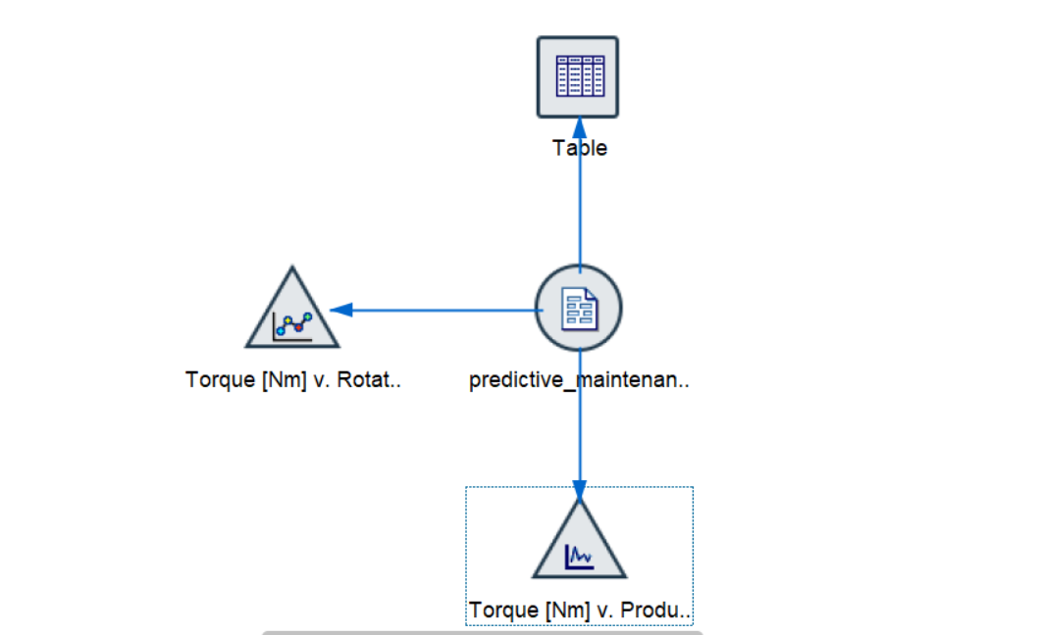
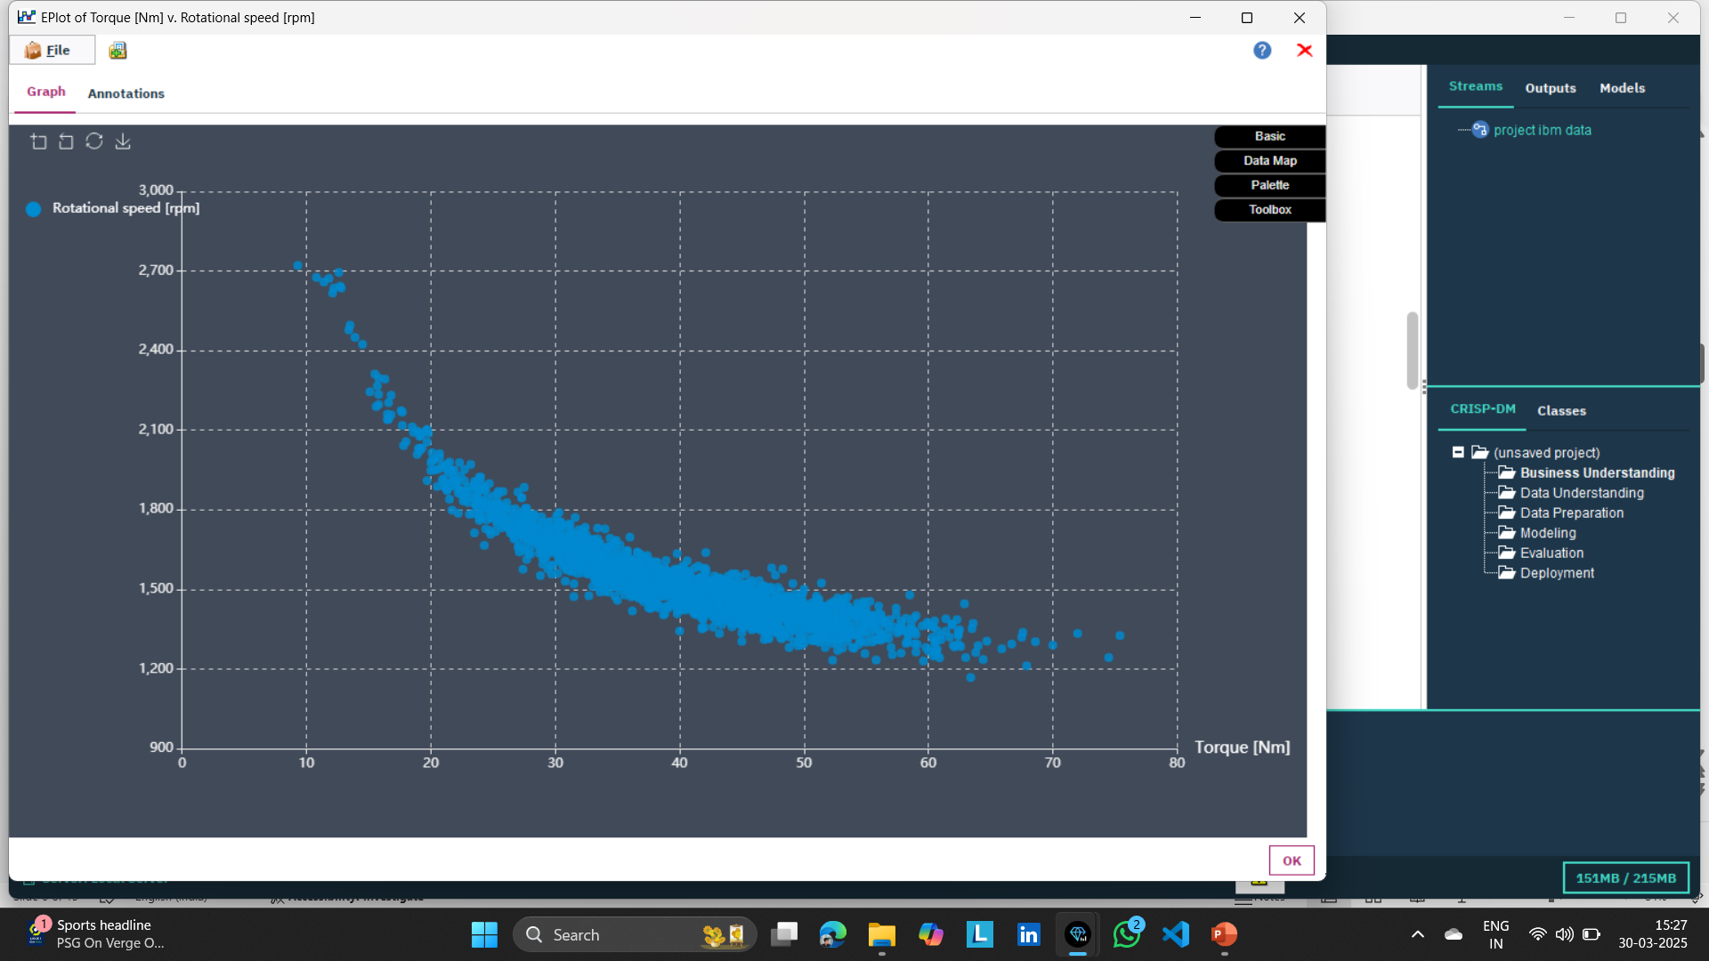
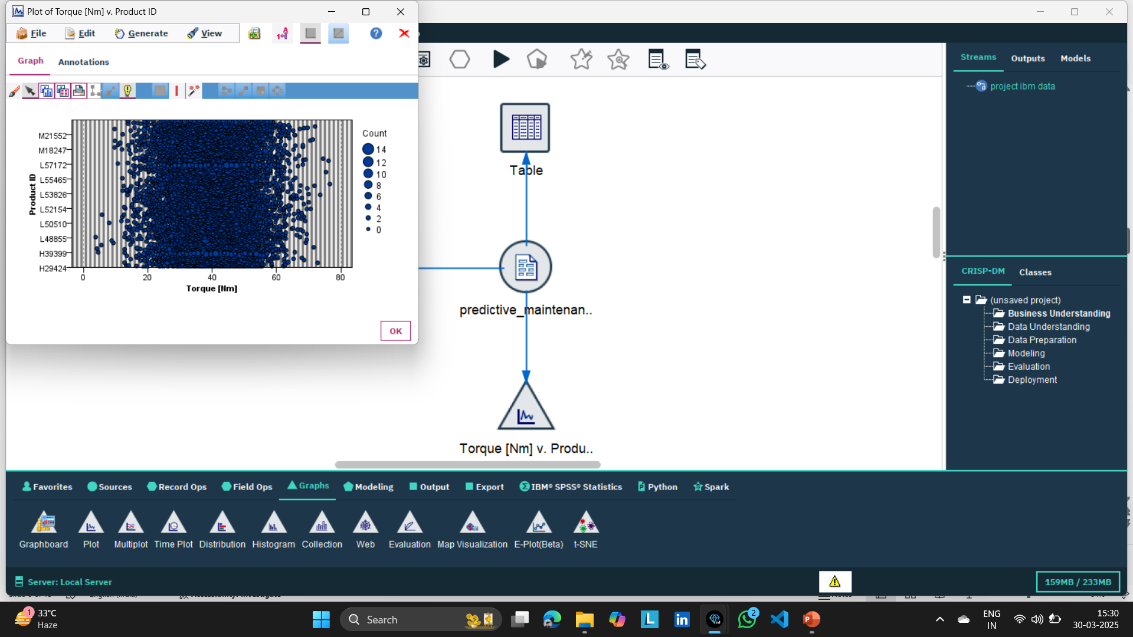
Importing &Understanding data
Fig 1. importing a company data of machines connect table and graph(plot graph),Eplot(Beta) Graph trying to understand data .
Seeing Table data and graph data fig-2 and fig-3 we can say which machine have perfect lies between 12-65 Torque appoximatly.Which machine have issue That Lies between 0-12 or bove 65 torque.

Slide 7
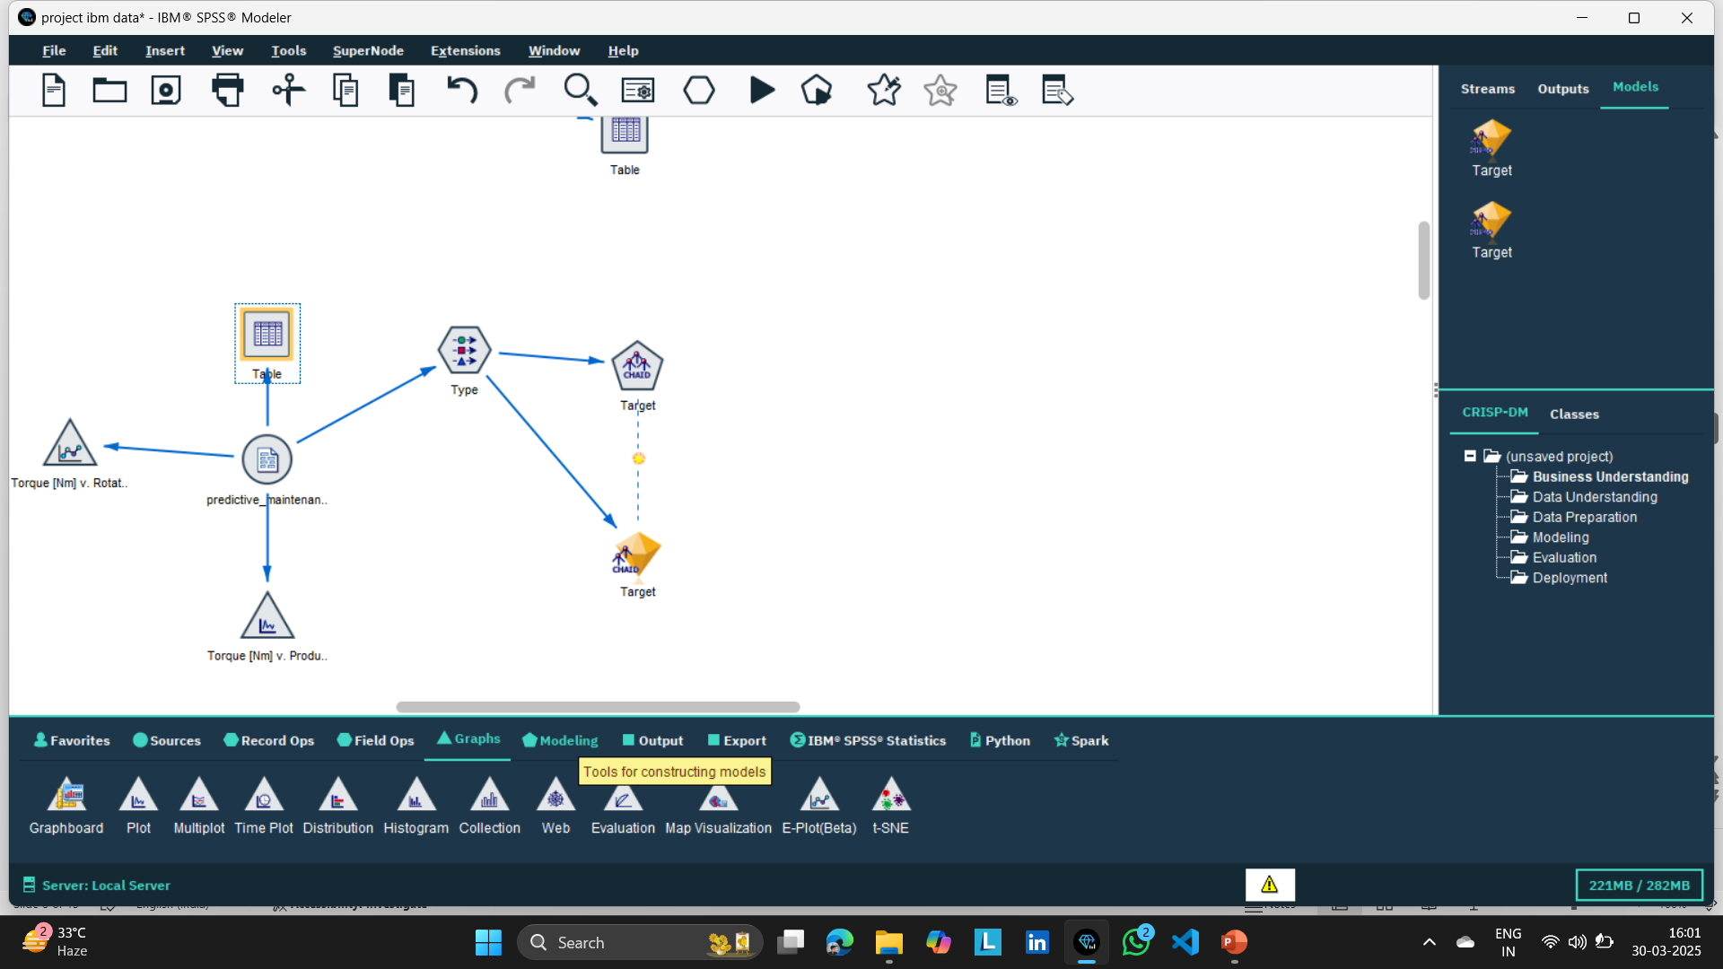
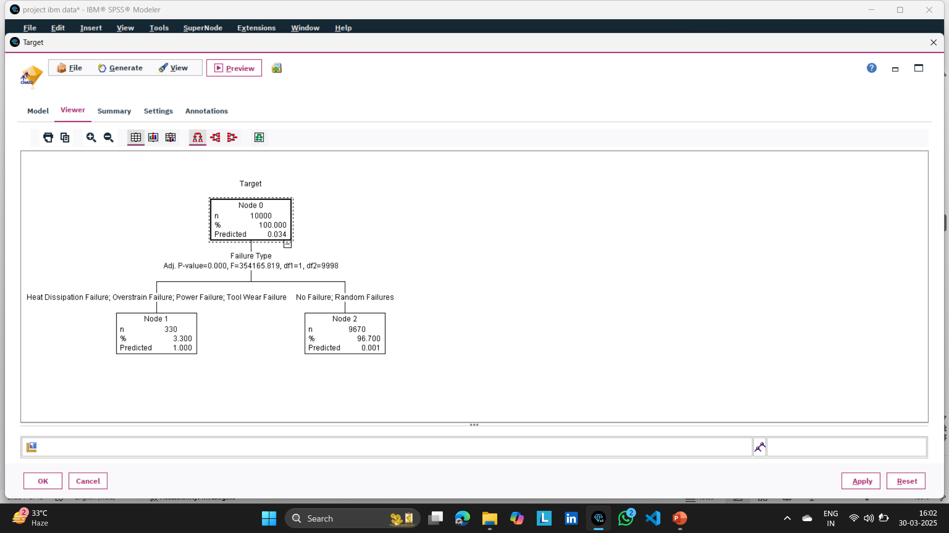
Machine Issue:X%|perfect:y%
Using Type And Chaid node we Predict how %of issue in machine how %is perfect in machine Chaid node we target a target value

Slide 8
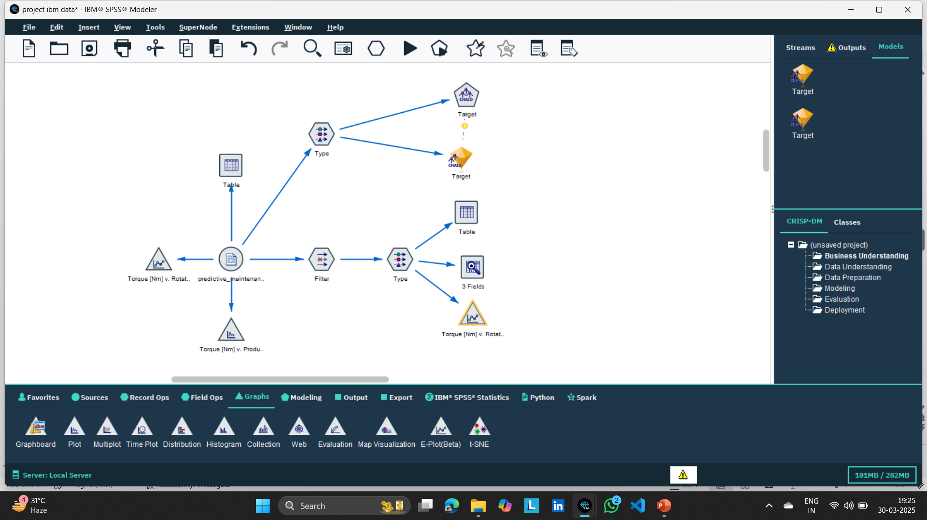
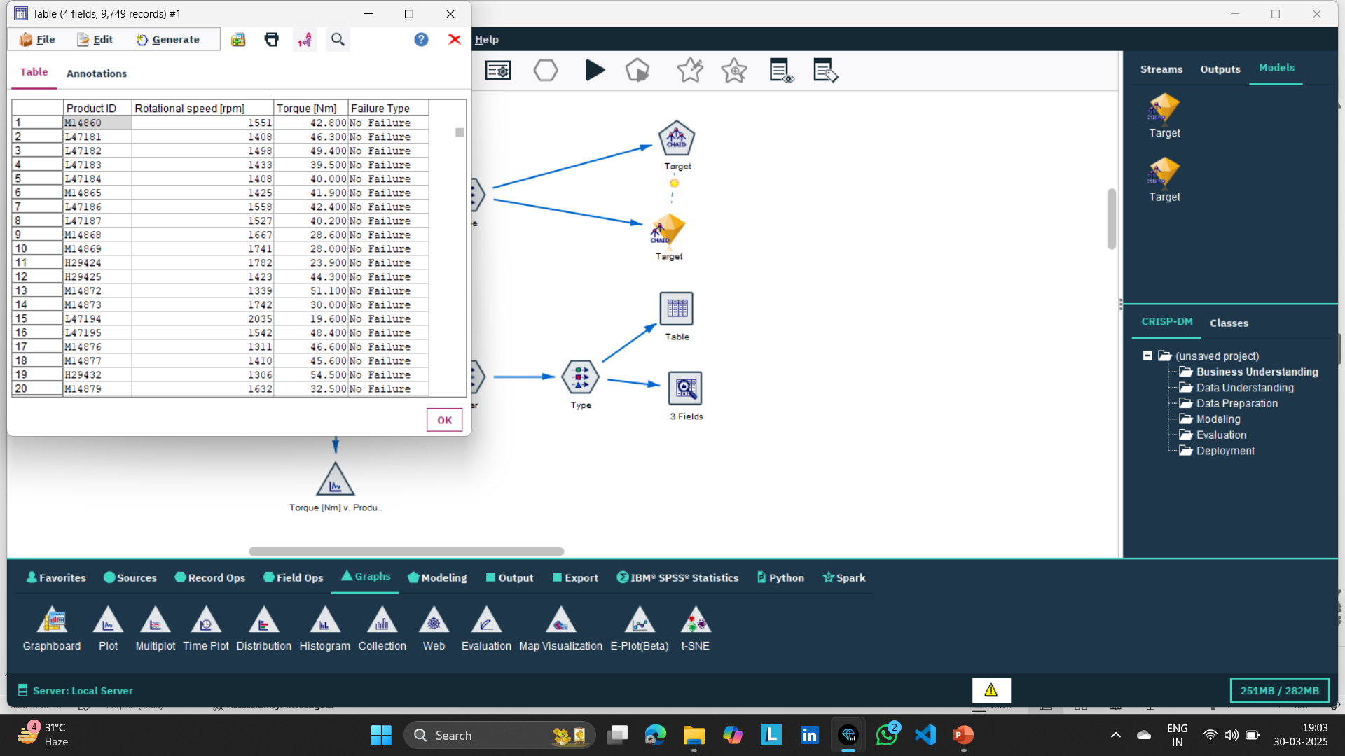
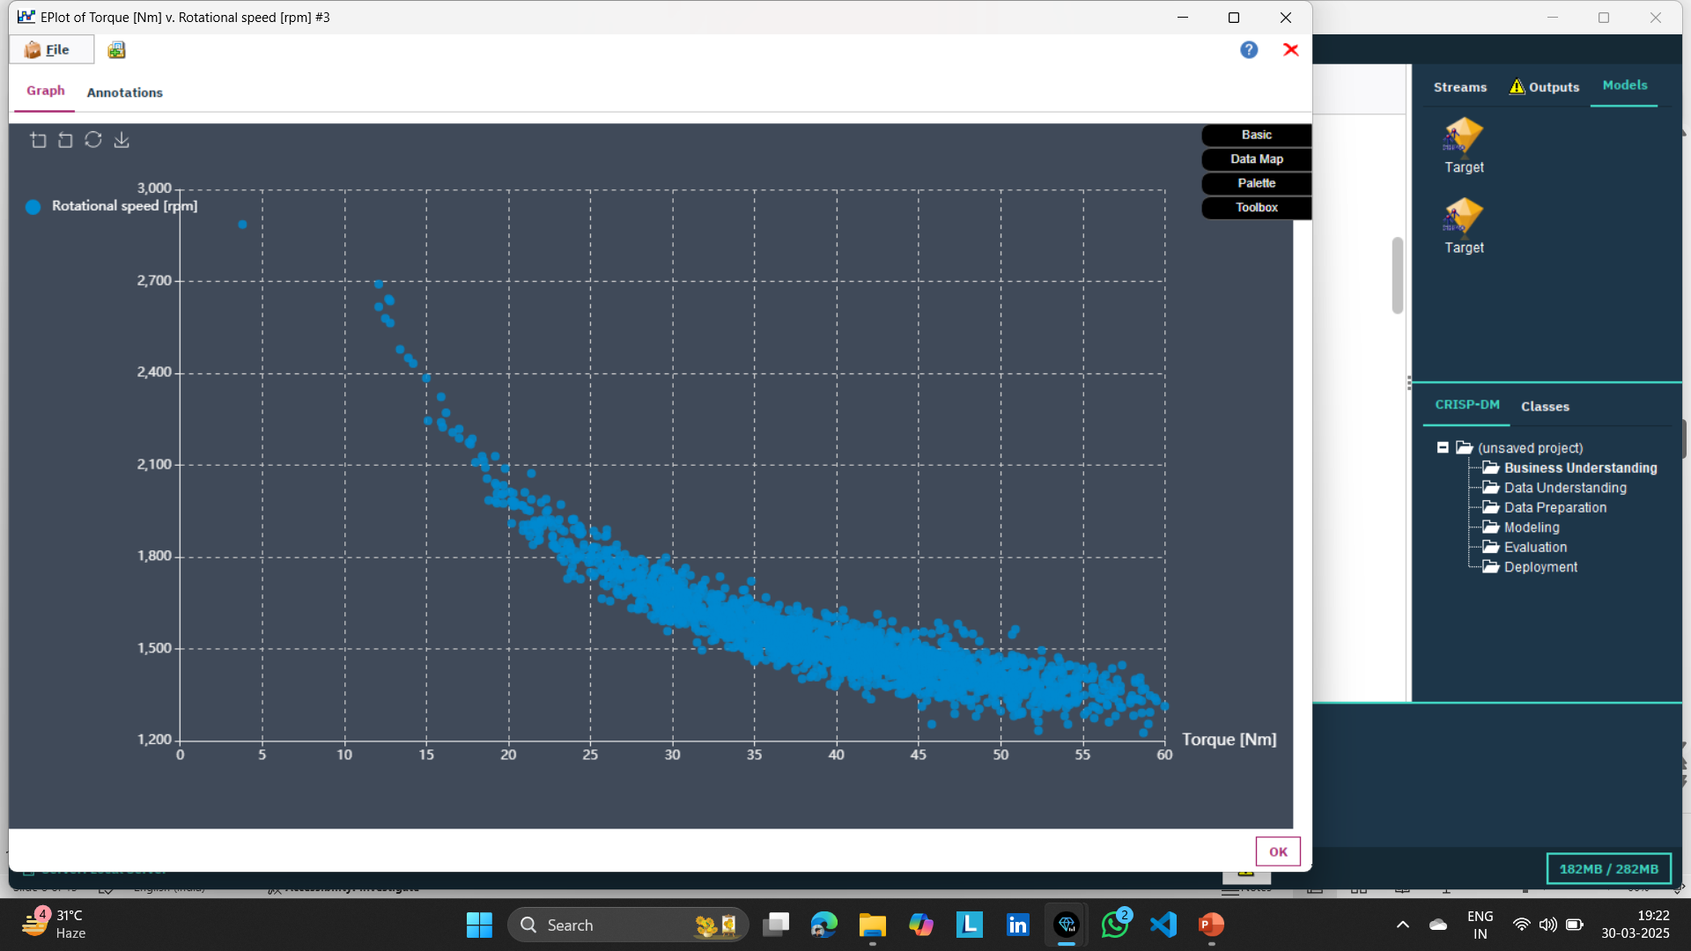
form data understanding we understand our perfect data were liess in rage of 12 to 65 TORQUE connect FILTER NODE WITH IT AND FILTER THAT FIELDS WHICH IS NOT GOING TO BE USE CONNECT TYPE NODE WITH IT WHICH HELPS TO READ DATA AND SPECIFY THE RAGE OF TORQUE DATA AND DISCARD OLD RANGE OF DATA TO SEE THAT WE CONNECT TABLE AND DATA AUDIT NODE WHRE WE CAN SEE OUR DATA WERE REPLACE BY PERFECT VALUE BY GRAPH WE CAN VERIFY MAXIMUM DATA LIES IN HIGH PROBALITY Zone.
Extracting perfect machine data

Slide 9
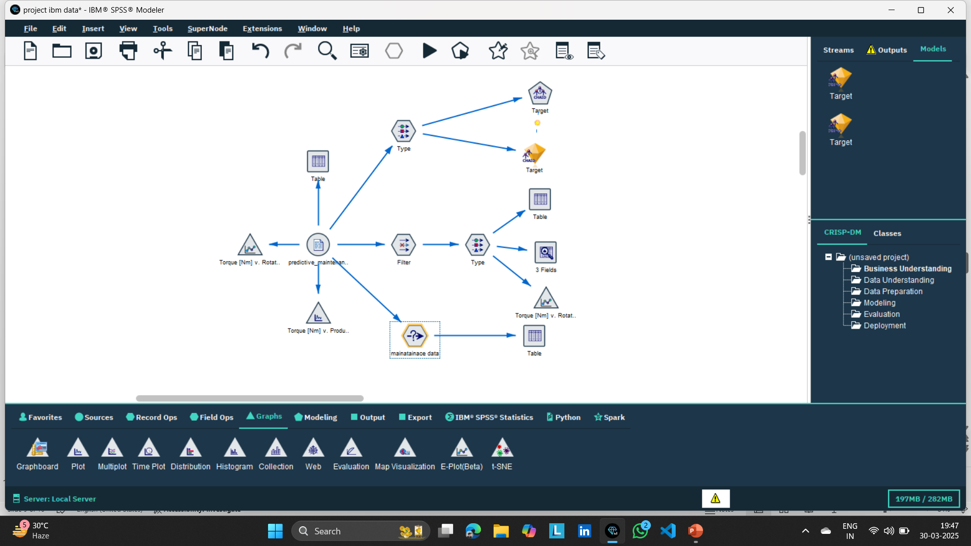
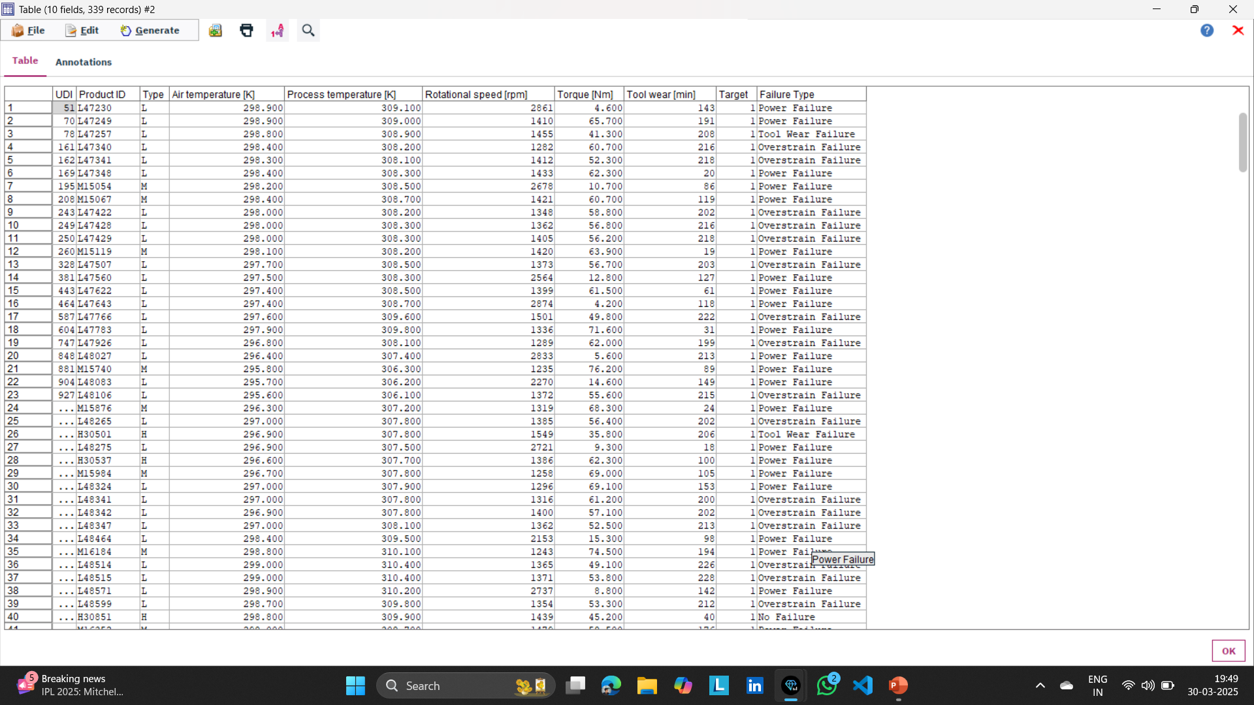
To know which machine have any kind of problems generate a data node Giving Condition Target =1; connect table with it you can see all data comes which have any kind of failure that needs to maintanance
Extracting Any issue machine Data

Slide 10
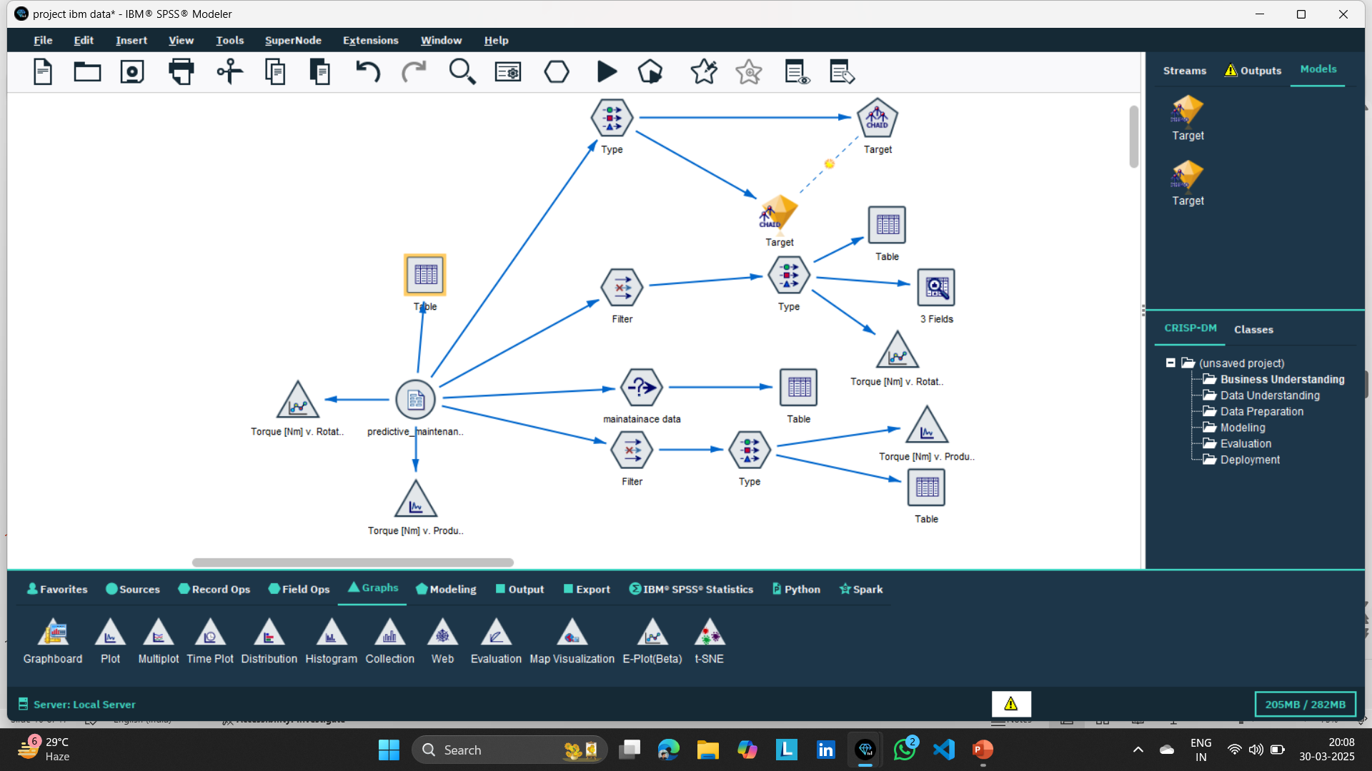
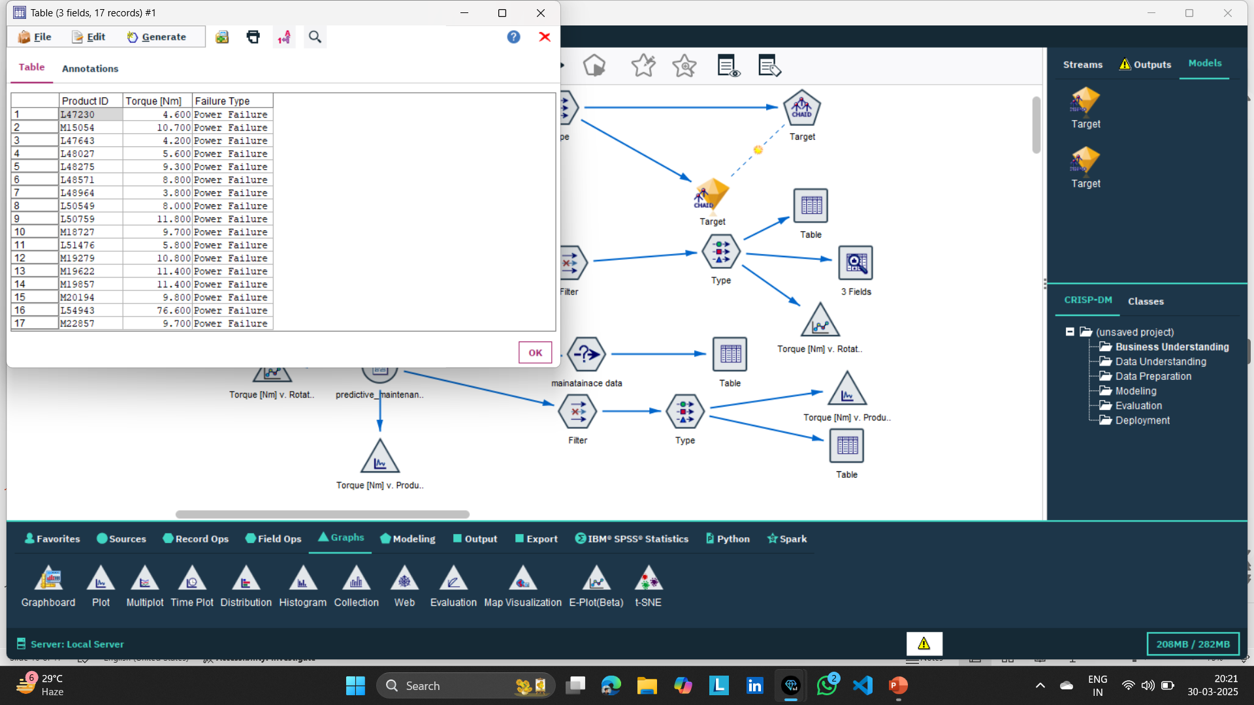
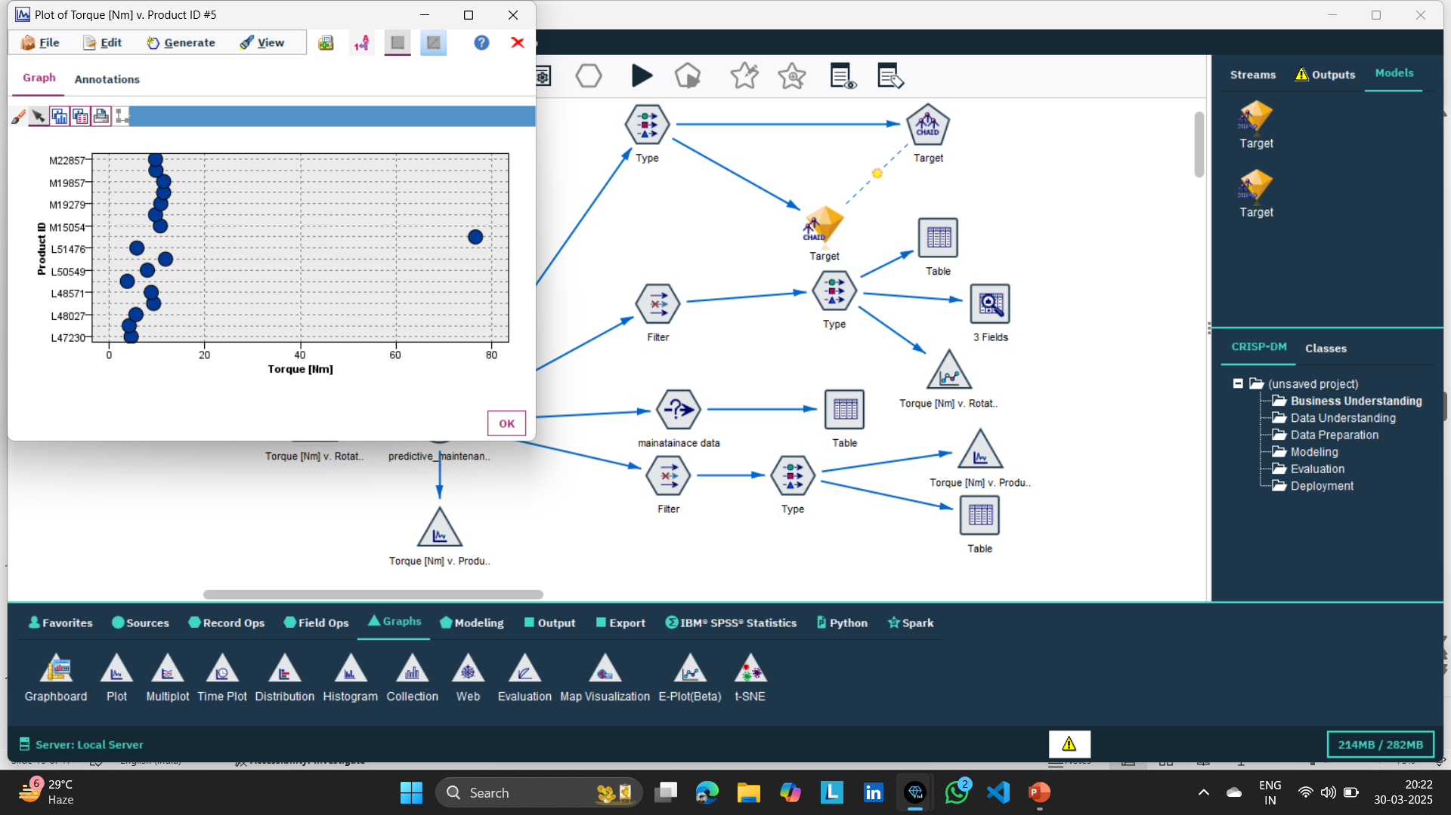
To extracting Power Failure Machine Data we connect filter node remove unvaluable field and connect type node read all field and we notice which torque less than 12 leads to power failure that rage specify in type node in torque Fields that how we can extract power failure machine data which can verify by graph and table
Extracting power Faliure Machine Data

Slide 11
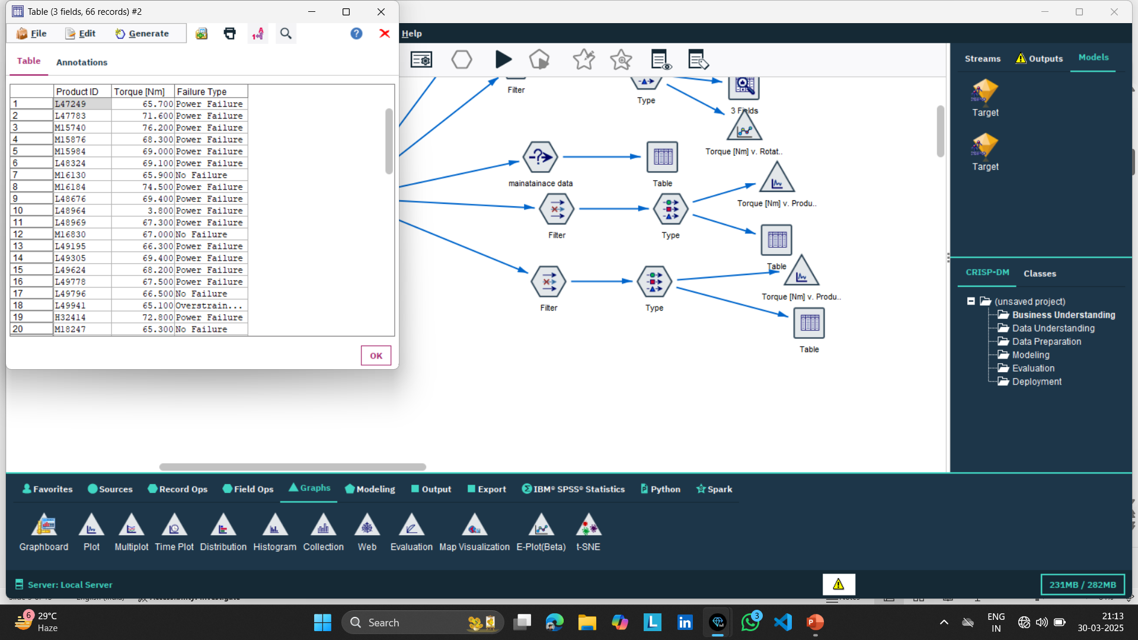
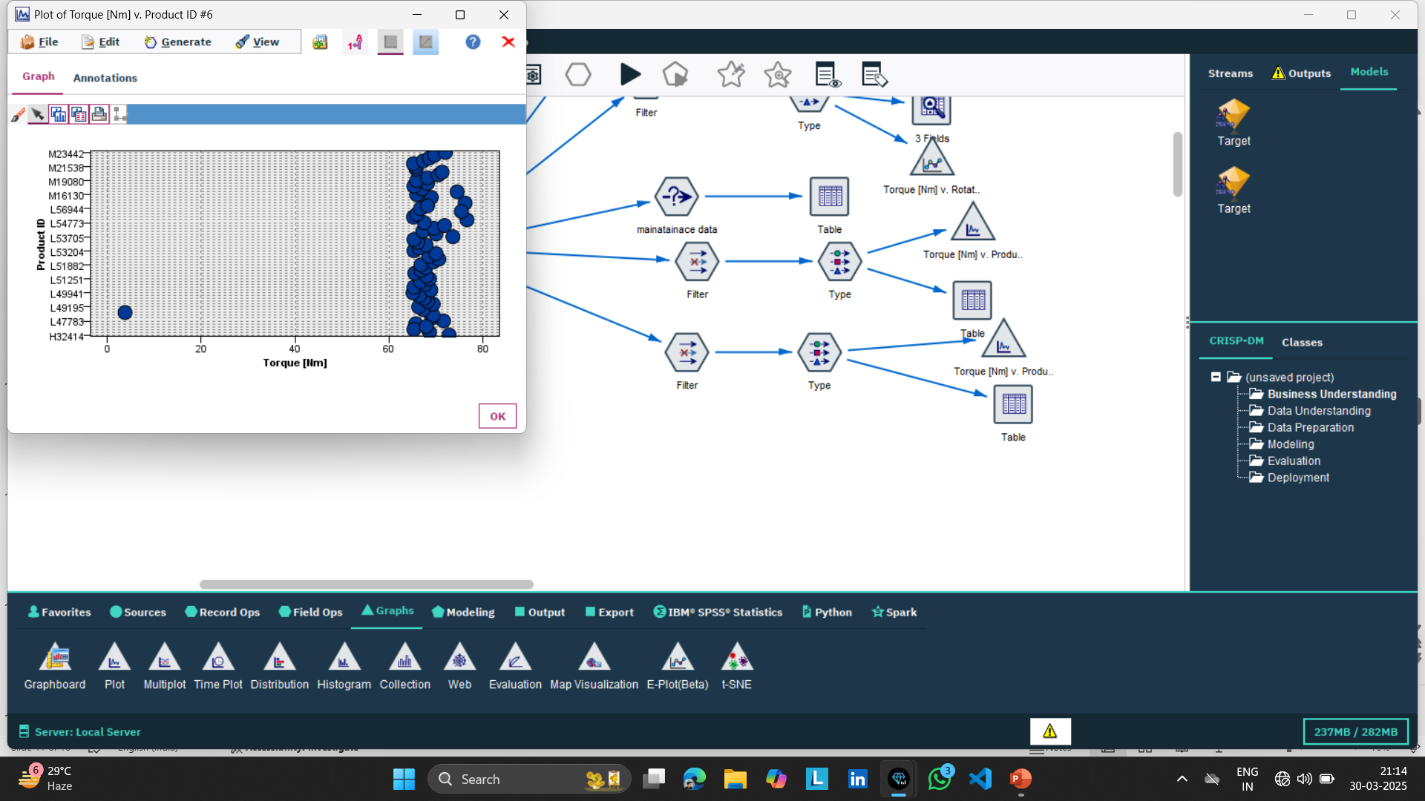
To extracting Power Failure Machine Data we connect filter node remove unvaluable field and connect type node read all fields and we notice which torque more than 67 leads to power failure that rage specify in type node in torque Fields that how we can extract power failure machine data which can verify by graph and table
Extracting power Faliure Machine Data

Slide 12
Conclusion
We extract our company machine failure data doing predictive analysis by help of this model we can send a machine in maintainace which needs to maintance
From different –different garh we can understand our data and implement our model

Slide 13

Gaurav Rao
gauravraoRao6@gmail.com

